Slide 1
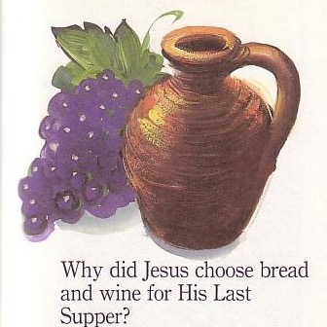
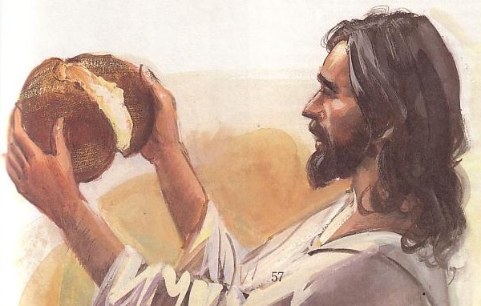
Passover & the Lord's Supper
118
Why did Jesus choose bread and wine for His Last Supper?
Dr. Rick Griffith • Jordan Evangelical Theological Seminary • BibleStudyDownloads.org

Slide 2
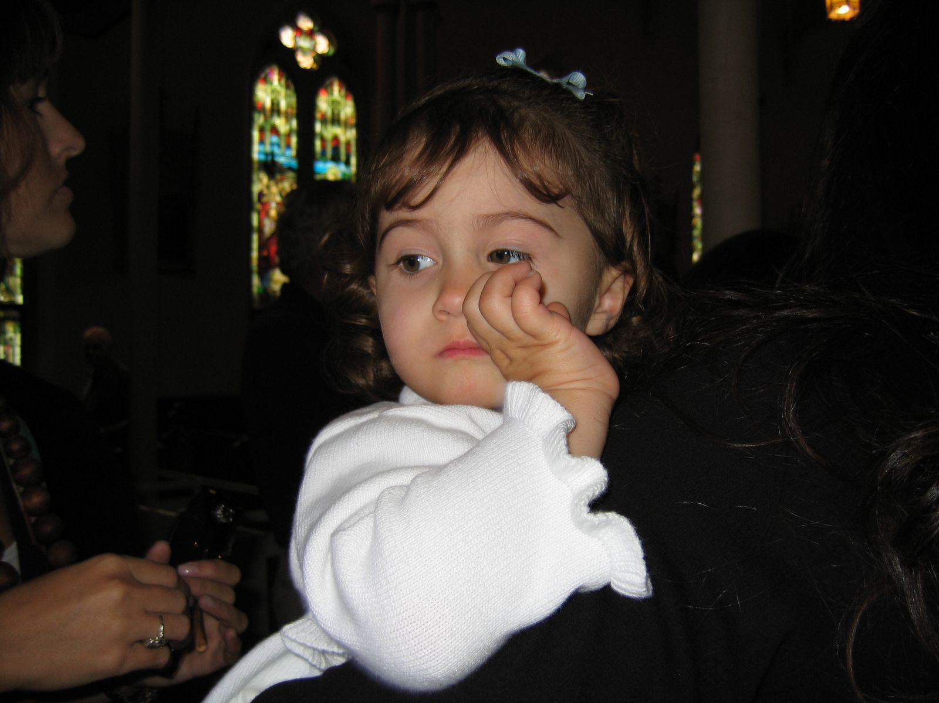
Sarah went to Big Church…
Notes:
2
Four-year old Sarah was just delighted one Sunday morning. Why? Because this was the Sunday she could attend “Big Church” with Mom and Dad. She was especially thrilled when the communion trays were being passed to her row…
At this point her parents realized that they had not yet explained to her why she couldn't take the elements. Mom and Dad got some but little Sarah was very upset that she couldn't get any. Her parents intended to talk to her about it later, but, as often happens, they forgot.
A few months later Sarah attended “Big Church” again with her parents, but this time it wasn't Communion Sunday. As everyone rose for the benediction and Sarah realized church was nearly over, she scornfully asked, “Aren't you going to have your little snack now?”

Slide 3
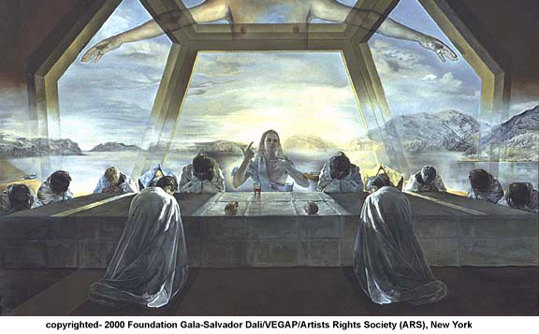
How can you honor God in the Lord's Supper?
Notes:
3
3

Slide 4
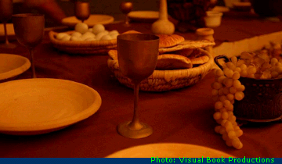
Eating & drinking in the presence of the Lord
118
????
Notes:
4
4
We chuckle at this—but then I wonder how many of us can provide our own understanding of what this celebration is all about.
Some of us have been believers for several years and taken the elements many times—yet we have little more understanding than this girl showed: “Oh, it has something to do with the death of Christ…”
The Lord's Supper is one activity that Christians do frequently which can lose its focus and be reduced to simply a “little snack.” Honestly, has it been meaningful experience for you each time? Don't you want it to be? And don't you want to make sure you are pleasing to the Lord as you take part? This is such a serious matter that some who have abused it have even gotten sick and died

Slide 5
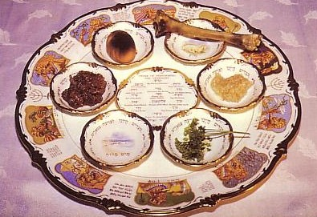
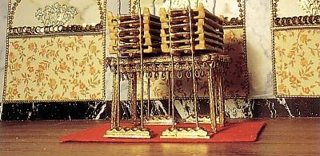
Seder Plate
118

Slide 6

The Agape (Love) Feast
118

Slide 7
Passover & the Lord's Supper
Four Comparisons
Notes:
7

Slide 8
The Four Directions
(Adapted from David Watson, I Believe in the Holy Spirit)
119
Look... | Passover (Jewish) | Lord's Supper (Christian)
Outward | Whole family involved (Exod. 12:3-4, 16) | Fellowship and unity (1 Cor. 11:17-22; 10:16-17)
Back | Deliverance from Egypt (Exod. 12:31-42) | Deliverance from sin (1 Cor. 11:23-25)
Forward | Wait for messianic age (Ezek. 45:21) | Anticipate return of Christ (1 Cor. 11:26; Mark 14:25)
Inward | Purify house of leaven or evil (Exod. 12:8, 15) | Examine sin in yourself (1 Cor. 11:27-32; cf. 5:6-8)

Slide 9
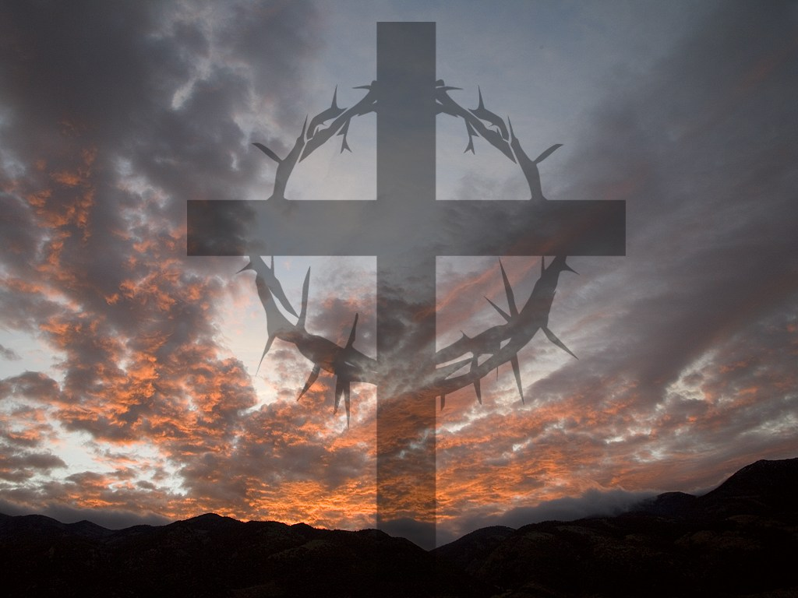
I. Look outward at your relationship with other believers
The Four Directions
outward
Notes:
9

Slide 10
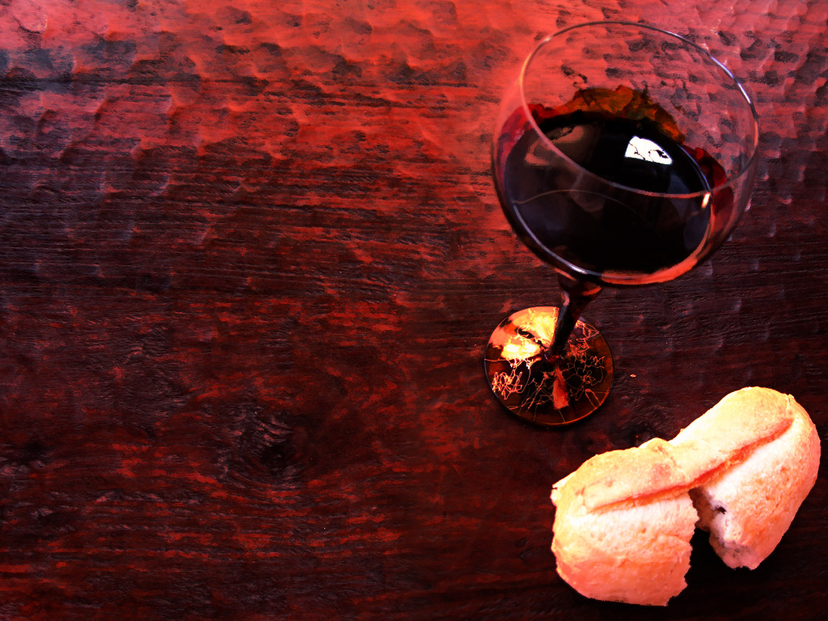
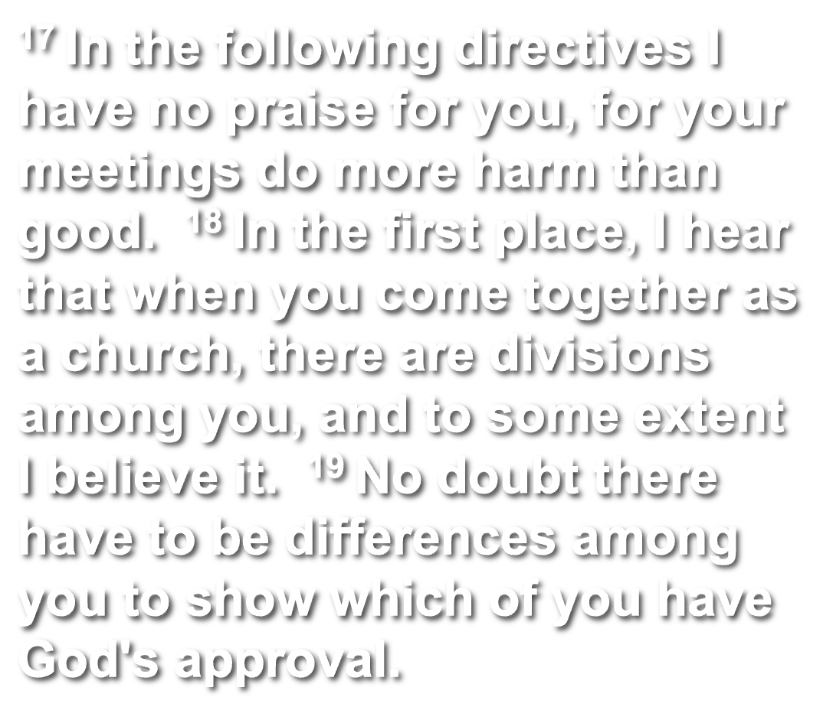
1 Corinthians 11:17-19 (NLT)
Notes:
10
10

Slide 11
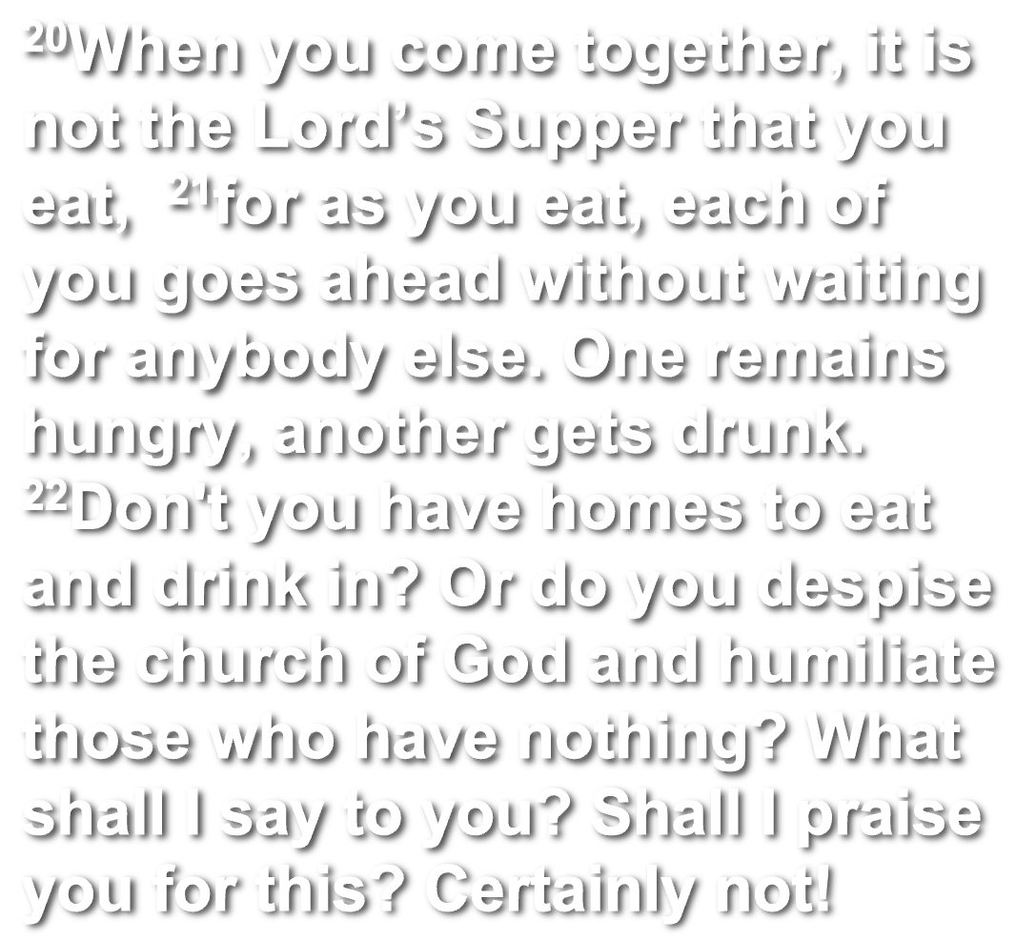
1 Corinthians 11:20-22 (NLT)
Notes:
11
11

Slide 12
The Agape (Love) Feast
Notes:
12

Slide 13

1 Cor 10:15-17 (NLT)
15 You are reasonable people. Decide for yourselves if what I am saying is true. 16 When we bless the cup at the Lord's Table, aren't we sharing in the blood of Christ? And when we break the bread, aren't we sharing in the body of Christ? 17 And though we are many, we all eat from one loaf of bread, showing that we are one body. 18 Think about the people of Israel. Weren't they united by eating the sacrifices at the altar?
Notes:
13
13

Slide 14
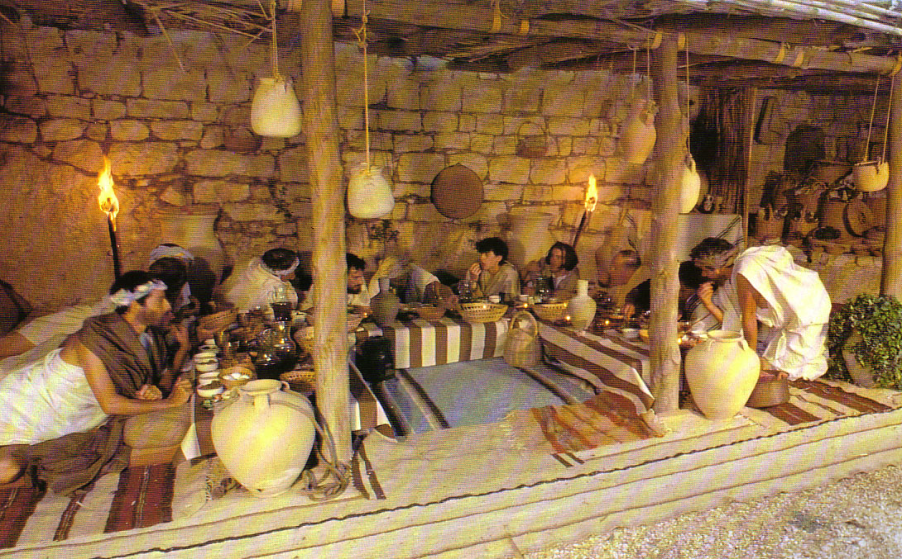
Seating at Jesus' Passover
Notes:
14

Slide 15
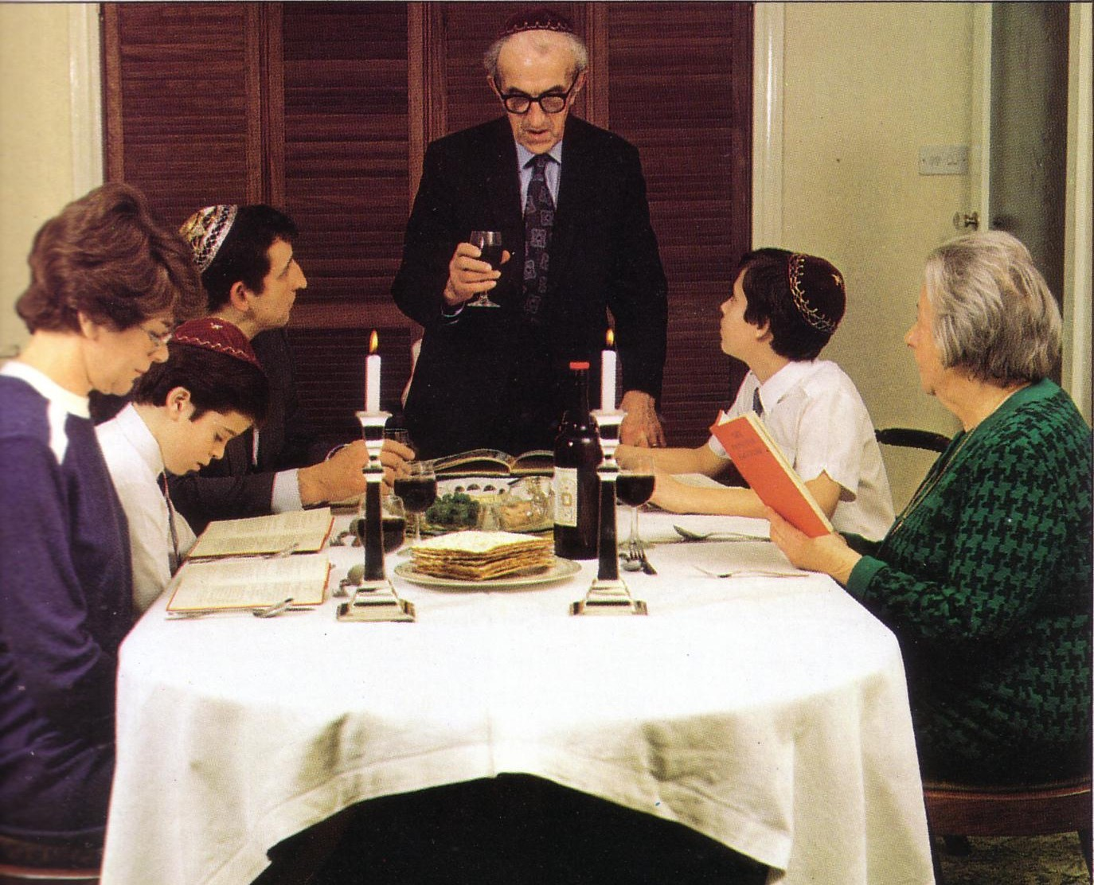
Modern Passover
Notes:
15

Slide 16
I. Look outward at your relationship with other believers
The Four Directions
outward
Notes:
16

Slide 17


Matthew 5:23-24
126

Slide 18
Matthew 5:23-24
126
?
"Therefore if you are presenting your offering at the altar, and there remember that your brother has something against you, leave your offering there before the altar and go; first be reconciled to your brother, and then come and present your offering.”

Slide 19
II. Look back at Christ's death for you
The Four Directions
outward
back
Notes:
19

Slide 20
1 Corinthians 11:23-25
²³For I received from the Lord what I also passed on to you: The Lord Jesus, on the night he was betrayed, took bread, ²⁴and when he had given thanks, he broke it and said, "This is my body, which is for you; do this in remembrance of me." ²⁵In the same way, after supper he took the cup, saying, "This cup is the new covenant in my blood; do this, whenever you drink it, in remembrance of me."
Notes:
20
20

Slide 21
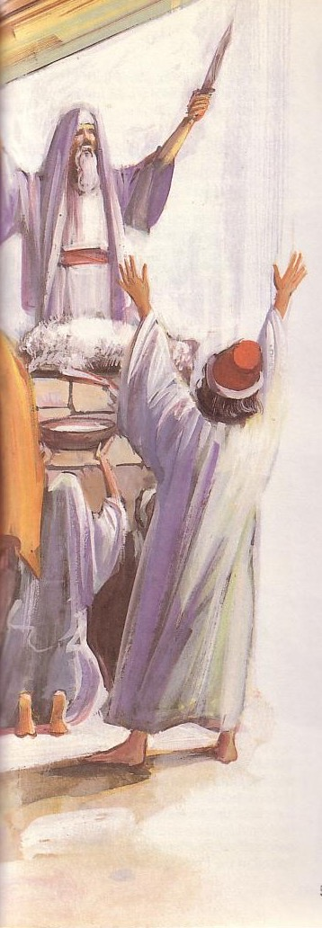

Passover's Past Significance
Notes:
21

Slide 22
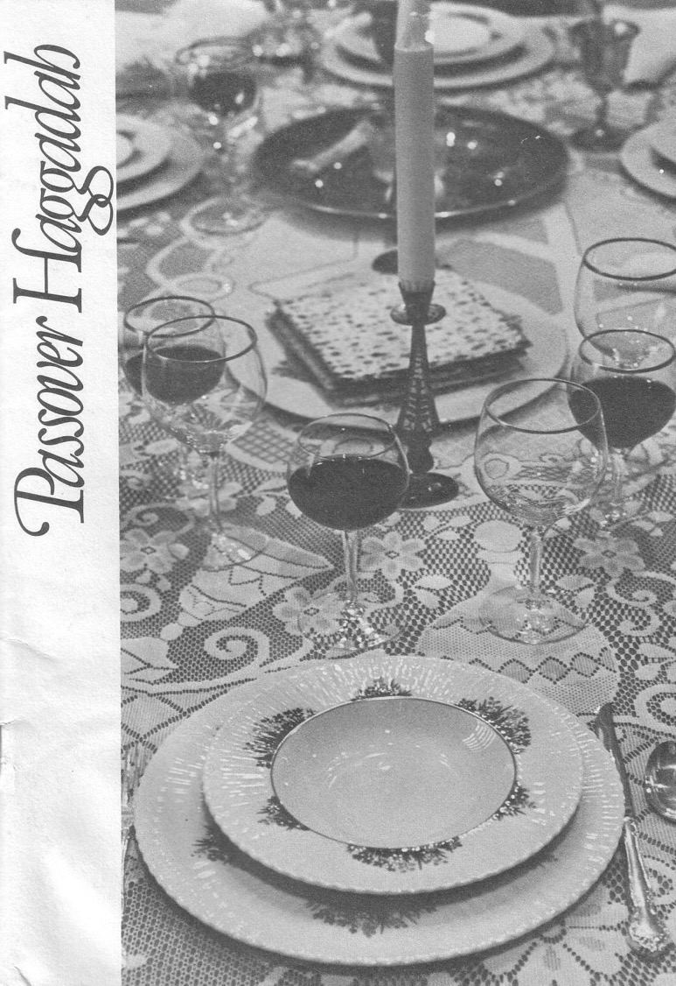
The Four Cups (Exod. 6:6-7)
Blessing
Plagues
Redemption
Praise
Notes:
22

Slide 23
The Order of the Celebrations
Passover | Lord's Supper
Light candles | Assumed (not recorded)
1st Cup: Blessing/Sanctification, saying, “I will bring you out from under the burdens of the Egyptians” (1st of 4 “I wills” of Exod. 6:6-7) | “Take this and divide it among yourselves… I will not drink again of the fruit of the vine until the kingdom of God comes” (Luke 22:17b-18)
Washing of one's own hands | Washed disciples feet during meal (John 13:2, 4)
Parsley dipped in salt water (bitterness), middle matzah (bread) made visible and broken and 1/2 called “afikomen” (Gr. “he who comes later”) wrapped with napkin and hidden | Son of God (second member of the Trinity) made visible, broken, body wrapped, and buried in a tomb (this tradition was added to the Passover by first century AD Jewish believers)
Passover story read (Exod. 12:1-13), 4 Questions, 4 sons, 10 Plagues | Assumed (not recorded)
Notes:
23

Slide 24
Seder Plate
Notes:
24

Slide 25
The Order of the Celebrations
Passover | Lord's Supper
2nd Cup: Plagues/Judgment, saying, “I will rid you of their bondage”
Washing hands, eat upper and 1/2 middle matzah and bitter herbs with bottom matzah (bondage)
Passover Supper begins
Eat bitter herbs with charoseth of dates, honey, & almonds (sweetness of life with God's redemption), roasted egg (temple offerings & destruction, grief and new life), shankbone | Jesus dips the sop with Judas and Judas leaves (?)
Eat afikomen—“This is the bread of affliction…” | “This is my body…” (Luke 22:19)
Notes:
25

Slide 26
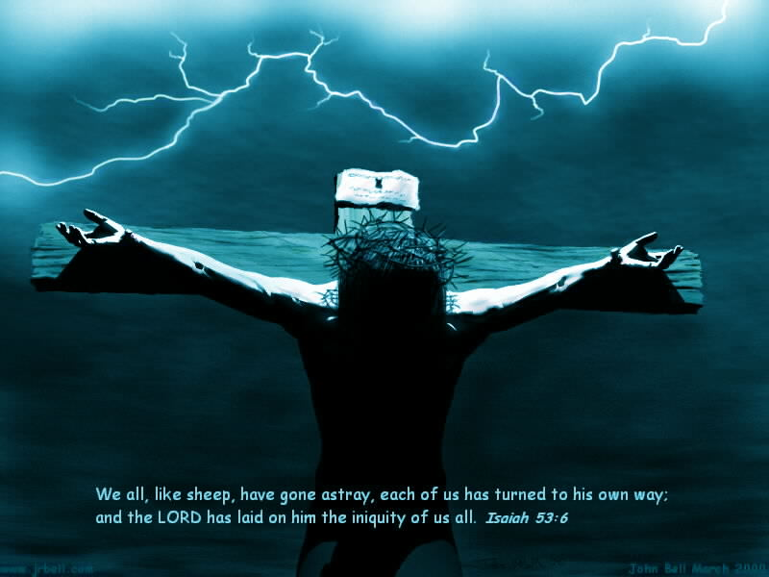
“This is my body, which is for you…”
Notes:
26
26

Slide 27
The Four Cups (Exod. 6:6-7)
Blessing
Plagues
Redemption
Praise
Notes:
27

Slide 28
The Order of the Celebrations
144
Passover | Lord's Supper
3rd Cup: Redemption, saying, “I will redeem you with an outstretched arm” | “This is my blood…” (Luke 22:20) Jesus dips the sop with Judas and Judas leaves (?)
4th Cup: Praise/Regathering, saying, “I will take you to me for a people” & read Pss. 113–118 | “For as often as you eat this bread and drink this cup, you proclaim the Lord's death until he comes”
Declaration (“Next year in Jerusalem!”), hymn (Ps. 118), poem, or national anthem | Sang hymn & went to Mt. of Olives (Matt. 26:30)
Cup of Elijah: Filled but untouched; symbolizes his return before Messiah (Mal. 4:5-6; Matt. 11:13-14; 17:11-12; Rev. 11:3-12; 19:11-21), youngest child opens front door “for Elijah” | Assumed (not recorded)
Notes:
28

Slide 29

“This cup is the new covenant in my blood” (Jer 31: 31-34)
Israel and Judah reunited (31:31-32)
Spirit indwelling (31:33)
No need for evangelism (31:34a)
Israel forgiven (31:34b)
Notes:
29
29

Slide 30
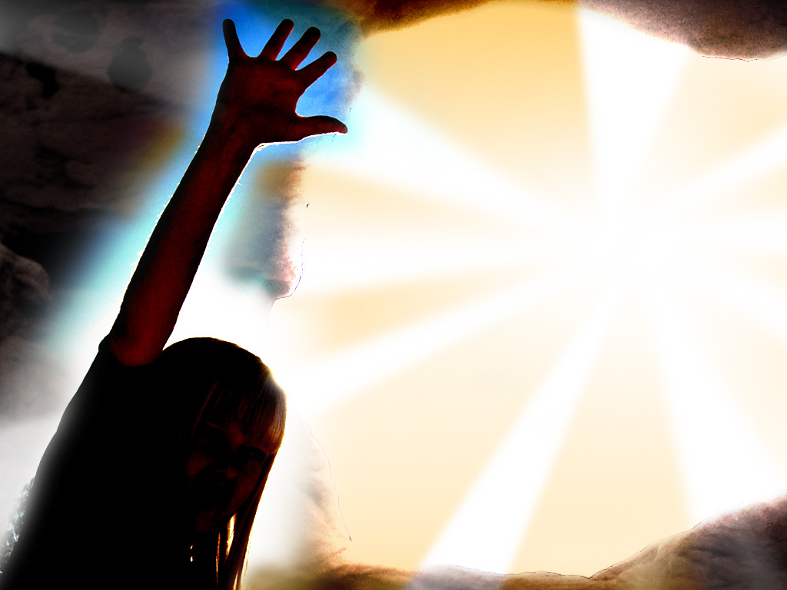
Song
“I'm not what
I wanna be,
I'm not what
I'm gonna be,
But thank God
I'm not what I was!”
Notes:
30
30

Slide 31
II. Look back at Christ's death for you
The Four Directions
outward
back
Notes:
31

Slide 32
III. Look forward to Christ's second coming
The Four Directions
outward
back
forward
Notes:
32

Slide 33
1 Corinthians 11:26 (NLT)
²⁶For whenever you eat this bread and drink this cup, you proclaim the Lord's death until he comes.
Notes:
33
33

Slide 34
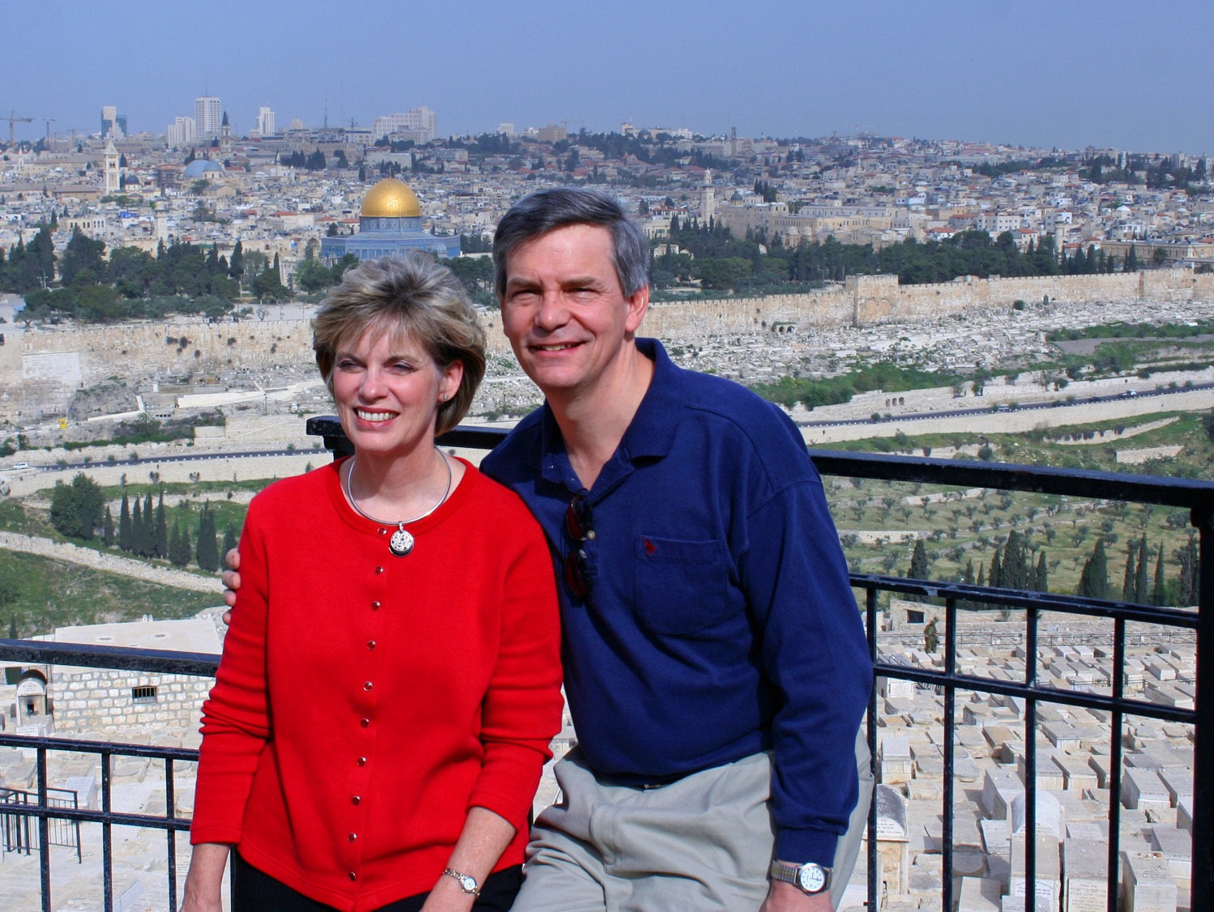
“This year we are here.
Next year in Jerusalem!”
Notes:
34

Slide 35
III. Look forward to Christ's second coming
The Four Directions
outward
back
forward
Notes:
35

Slide 36
IV. Look inward to deal with any unconfessed sin
The Four Directions
outward
back
forward
inward
Notes:
36

Slide 37
1 Corinthians 11:27-29 (NLT)
²⁷Therefore, whoever eats the bread or drinks the cup of the Lord in an unworthy manner will be guilty of sinning against the body and blood of the Lord. ²⁸A man ought to examine himself before he eats of the bread and drinks of the cup. ²⁹For anyone who eats and drinks without recognizing the body of the Lord eats and drinks judgment on himself.
Notes:
37
37

Slide 38
1 Corinthians 11:30-32 (NLT)
³⁰ That is why many among you are weak and sick, and a number of you have fallen asleep. ³¹But if we judged ourselves, we would not come under judgment. ³²When we are judged by the Lord, we are being disciplined so that we will not be condemned with the world.
Notes:
38
38

Slide 39
1 Corinthians 11:33-34 (NLT)
³³So then, my brothers, when you come together to eat, wait for each other. ³⁴If anyone is hungry, he should eat at home, so that when you meet together it may not result in judgment. And when I come I will give further directions.
Notes:
39
39

Slide 40




Feast of Unleavened Bread
Notes:
40
www.stephenwilliamson.com/ Hobbies/bakin.htm (Yeast bloom)

Slide 41
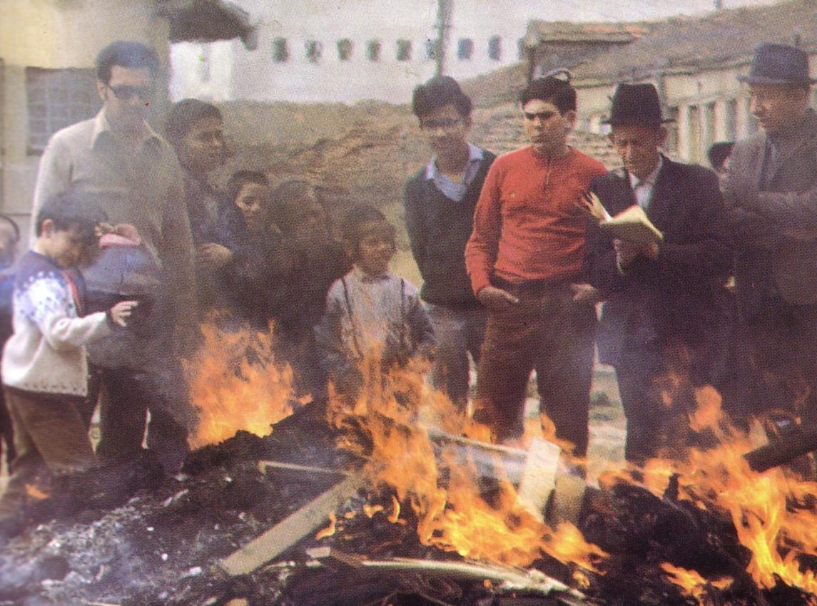
“Burn All the Yeast!”
Notes:
41

Slide 42

Think!
inward
Notes:
42

Slide 43
Look in all four directions!
The Four Directions
outward
back
forward
inward
Notes:
43

Slide 44
The Four Directions
(Adapted from David Watson, I Believe in the Holy Spirit)
143
Look... | Passover (Jewish) | Lord's Supper (Christian)
Outward | Whole family involved (Exod. 12:3-4, 16) | Fellowship and unity (1 Cor. 11:17-22; 10:16-17)
Back | Deliverance from Egypt (Exod. 12:31-42) | Deliverance from sin (1 Cor. 11:23-25)
Forward | Wait for messianic age (Ezek. 45:21) | Anticipate return of Christ (1 Cor. 11:26; Mark 14:25)
Inward | Purify house of leaven or evil (Exod. 12:8, 15) | Examine sin in yourself (1 Cor. 11:27-32; cf. 5:6-8)
Notes:
44

Slide 45
To properly look back on His death and look forward to His return, we need to look outward for others and look inward at our own lives.
The Main Idea
outward
back
forward
inward
Notes:
45

Slide 46

John 3:16
Notes:
46

Slide 47
What outward or inward issues do you need to address right NOW?
Two Directions
outward
inward
Notes:
47

Slide 48
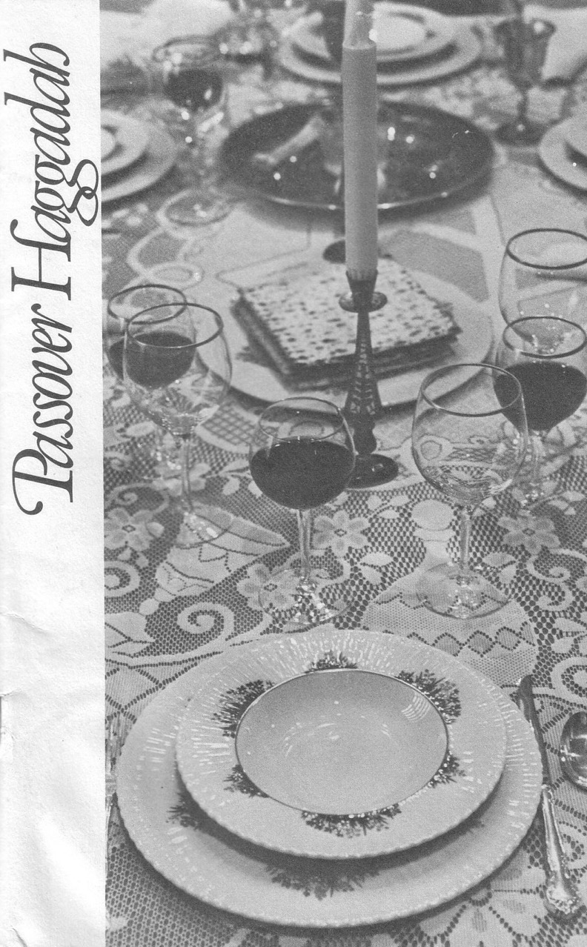
The Four Cups
120

Slide 49
The Order of the Celebrations
120
Passover | Lord's Supper
Light candles | Assumed (not recorded)
1st Cup: Blessing/Sanctification, saying, “I will bring you out from under the burdens of the Egyptians” (1st of 4 “I wills” of Exod. 6:6-7) | “Take this and divide it among yourselves… I will not drink again of the fruit of the vine until the kingdom of God comes” (Luke 22:17b-18)
Washing of one's own hands | Washed disciples feet during meal (John 13:2, 4)
Parsley dipped in salt water (bitterness), middle matzah (bread) made visible and broken and 1/2 called “afikomen” (Gr. “he who comes later”) wrapped with napkin and hidden | Son of God (second member of the Trinity) made visible, broken, body wrapped, and buried in a tomb (this tradition was added to the Passover by first century AD Jewish believers)
Passover story read (Exod. 12:1-13), 4 Questions, 4 sons, 10 Plagues | Assumed (not recorded)

Slide 50
The Order of the Celebrations
120
Passover | Lord's Supper
2nd Cup: Plagues/Judgment, saying, “I will rid you of their bondage”
Washing hands, eat upper and 1/2 middle matzah and bitter herbs with bottom matzah (bondage)
Passover Supper begins
Eat bitter herbs with charoseth of dates, honey, & almonds (sweetness of life with God's redemption), roasted egg (temple offerings & destruction, grief and new life), shankbone | Jesus dips the sop with Judas and Judas leaves (?)
Eat afikomen—“This is the bread of affliction…” | “This is my body…” (Luke 22:19)

Slide 51
The Order of the Celebrations
121
Passover | Lord's Supper
3rd Cup: Redemption, saying, “I will redeem you with an outstretched arm” | “This is my blood…” (Luke 22:20) Jesus dips the sop with Judas and Judas leaves (?)
4th Cup: Praise/Regathering, saying, “I will take you to me for a people” & read Pss. 113–118 | “For as often as you eat this bread and drink this cup, you proclaim the Lord's death until he comes”
Declaration (“Next year in Jerusalem!”), hymn (Ps. 118), poem, or national anthem | Sang hymn & went to Mt. of Olives (Matt. 26:30)
Cup of Elijah: Filled but untouched; symbolizes his return before Messiah (Mal. 4:5-6; Matt. 11:13-14; 17:11-12; Rev. 11:3-12; 19:11-21), youngest child opens front door “for Elijah” | Assumed (not recorded)

Slide 52
In what way is Christ present in the Lord's Supper?
122
Catholic: Transubstantiation
Lutheran: Consubstantiation
Other Protestant: Symbolic & Spiritual Presence

Slide 53
What will you do?
When visiting a Catholic church,
I will participate in the mass
(take the bread and wine).
When visiting a Lutheran church,
I will participate in the Lord's table
(take the bread and wine).

Slide 54
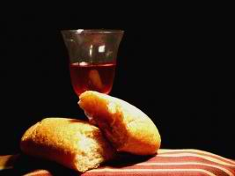
124
Questions about the Lord's Table?

Slide 55
Do you agree?
124-125
Only Christians should take the Lord's supper.
Only baptised Christians should take the Lord's supper.
Only Christians baptised by immersion should take the Lord's supper.
Leaders in a divided church should not allow the Lord's table served

Slide 56
Do you agree?
126
Only pastors should lead the Lord's supper.
Leaders should examine those taking the Lord's supper.
A church should take the Lord's supper monthly.

Slide 57
Applications
127
        How can you take the Lord's Supper in a worthier manner?
        Do you stop to evaluate yourself as a regular habit before partaking of the elements? How can you better do this?
        Are you in a right relationship with all members of the body so that participation is possible at the next occurrence? With whom do you need to reconcile before taking the Lord's Supper again?

Slide 58
Black

Slide 59


Church link at BibleStudyDownloads.org
Get this presentation for free!
Notes:
Church (ch)

